Slide 1




Test-Driven JavaScript with
Brad Urani
Director of Engineering
@BradUrani
linkedin.com/in/bradurani
www.gainupside.com

Slide 2

http://jasmine.github.io/2.0/introduction.html
https://github.com/pivotal/jasmine
Inspired by RSpec

Slide 3
Important Terms:
Suites: a collection of tests in single file - describe
Specs - AKA tests. Test a single condition only - it
Expectation - AKA assertions, verify result - expect
Matcher - Perform comparison - .toEqual, .toBe

Slide 4
TDD vs BDD
TDD is a development process
BDD is a business + development process

Slide 5
TDD vs TFD
TDD - Write tests as you code
TFD - Write all the tests first

Slide 6
Principles of good unit tests
Unit tests should test only one well-defined piece of functionality
Unit tests should only call a single function*
*Your mileage may vary

Slide 7
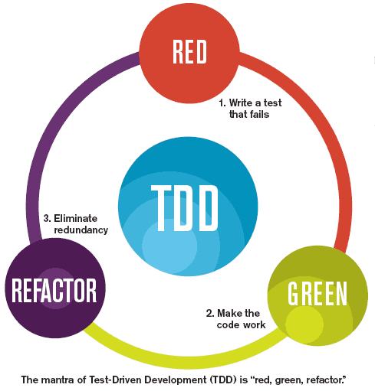

Slide 8
Important Questions
Do we test every method?
Do we test private methods?
When is a class too big?
When is a function too big?

Slide 9
Integration Tests
Test the entire system, front-to-back (usually including the database)
Must be idempotent between runs
Can be powered by Jasmine making AJAX calls, or testing against local storage (Web storage, IndexedDB, Cookies)

Slide 10
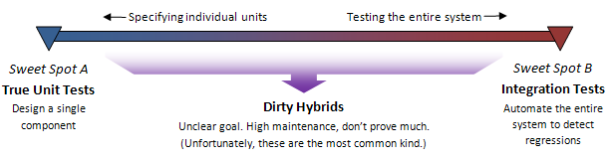
Avoid the Middle Ground

Slide 11
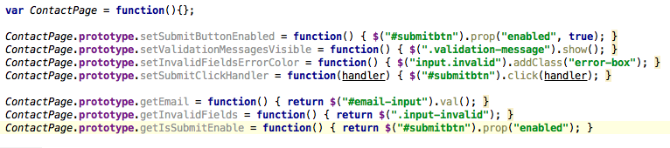
Behavioral Testing with the ‘Page’ pattern

Slide 12
Jasmine and CoffeeScript
describe "CoffeeScript Jasmine specs", ->
it "is beautiful!", ->
expect(" your code is so beautiful"). toBeTruthy()

Slide 13
Jasmine and NodeJS
jasmine-node require("../ src/ test.js");
it(" does an asynchronous call", function() {
exampleAsyncCall( function( response) {
expect( response). toContain(" something expected");
done();
});
});

Slide 14
Jasmine and Ruby
gem ‘jasmine’
rails generate jasmine:install
jasmine init
rake jasmine:ci

Slide 15
Jasmine with Jenkins and PhantomJS
Continuous Integration Solution for Jasmine
Runs multiple browsers simulations!

Slide 16
Benefits
Fewer Bugs
Confidence to refactor
Quick feedback about defects
Repeatable test
Living / trustworthy documentation
Frees up manual testers for more interesting exploratory testing

Slide 17
Costs:
Time spent writing the test
Time spent maintaining the test
Waiting for the test to run
Having a false sense of security when an automated test is passing

Slide 18
Is it worth it?
Yes, but…
Strike a balance
100% coverage is usually unnecessary
Beware testing previously written code
Continue to manually test
Maintain the Tests
Use Continuous Integration (CI)

Slide 19
Resources
Source: https://github.com/bradurani/ConwaysGameOfLifeJasmineDemo
Brad Urani
LinkedIn: http://linkedin.com/in/bradurani
Twitter: @BradUrani
Email: bradurani@gmail.com

